Slide 1


Robotic Process Automation using UiPath
Topic 7- Handle Errors in StudioX
HITESH KUMAR SHARMA
Technical Instructor & Consultant

Slide 2

Introduction to RPA
StudioX Citizen Developer Journey and Working with StudioX
Activity Recording, UI Automation in StudioX
Decisions, Iterations, and Scenarios in StudioX
File, Folder Automation in StudioX: Microsoft Excel Automation
Email & SAP Automation in StudioX
Handle Errors in StudioX
COURSE OBJECTIVES

Slide 3
7. HANDLE ERRORS IN STUDIOX
Validate and analyse your project
Troubleshoot your project
Automation best practices
Use UiPath resources
Basics of Error Handling in StudioX

Slide 4
VALIDATE AND ANALYZE Your Project (Hand-On)
Learning to automate your tasks can be a frustrating endeavor because you are destined to encounter errors along the way.
What'll make you successful isn't avoiding errors—no one can avoid them. Instead, you should understand that errors are part of the process and learn from them as you solve them.
In this lesson, you'll learn how to look for validation errors using the Validate and Analyze tools.
You'll explore the Unicorn Name exercise again, but this time something's not quite right. The project cannot be run.

Slide 5
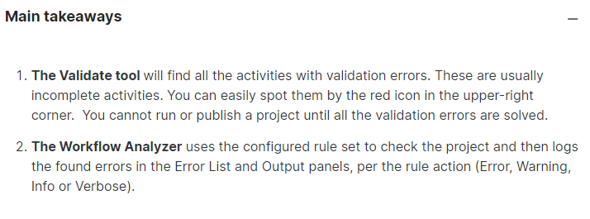
VALIDATE AND ANALYZE Your Project (Hand-On)

Slide 6
TROUBLESHOOT Your Project (Hand-On)
So far, you've used the Workflow Analyzer, a tool that'll help you anticipate some errors. But as you've discovered, they don't help you catch all the errors.
In this lesson, you'll discover a couple of techniques to help you localize the problems in your project.
You'll look once again at the Unicorn Name project. In the previous lesson we fixed validation errors. In this demo, we'll identify the errors in the project's logic.

Slide 7
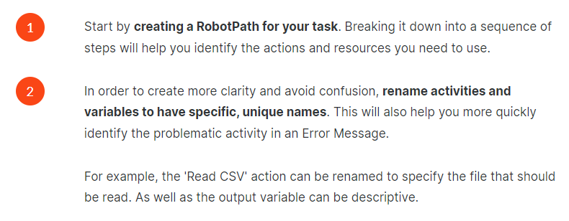
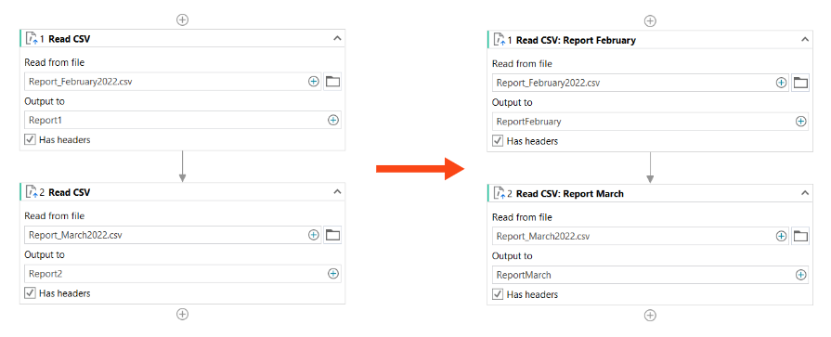
Automation Best Practices(Hand-On)

Slide 8
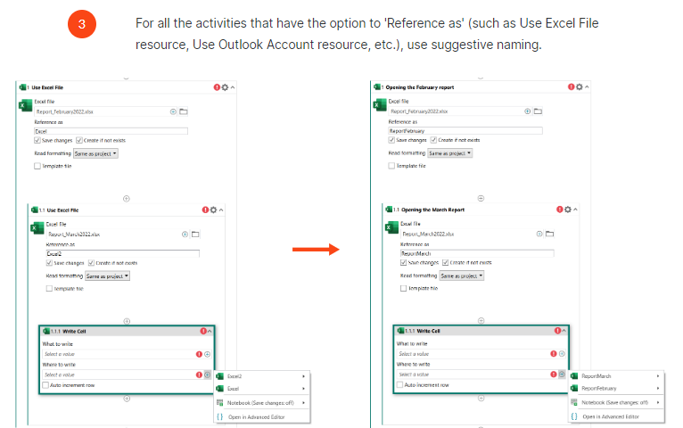
Automation Best Practices(Hand-On)

Slide 9
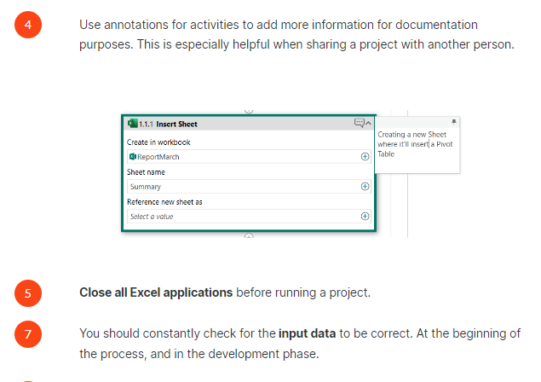
Automation Best Practices(Hand-On)

Slide 10
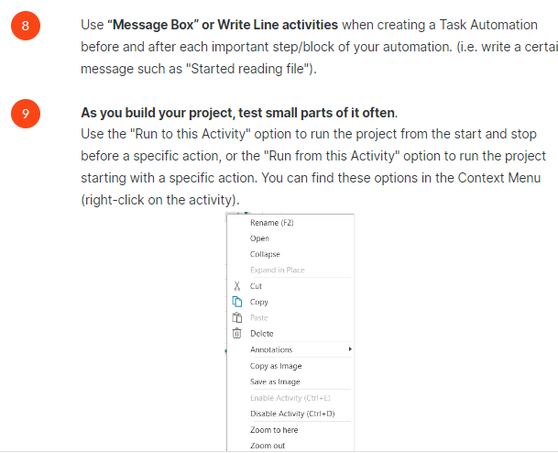
Automation Best Practices(Hand-On)

Slide 11
Use UiPath Resources
There may be times when best practices and the tools embedded in StudioX won't solve your problem. When you don't understand the error or your solution isn't exactly right, you turn to the internet for help.
In this lesson, we'll talk about what other UiPath resources, besides the UiPath Academy, you can use when you find yourself stuck.

Slide 12
TOPIC 7
END
THANK YOU

